Slide 1
Air Pollution
Sprint update

Slide 2
Table of content
The past
The present
The future
Demo

Slide 3
The past
What we did in the past.

Slide 4
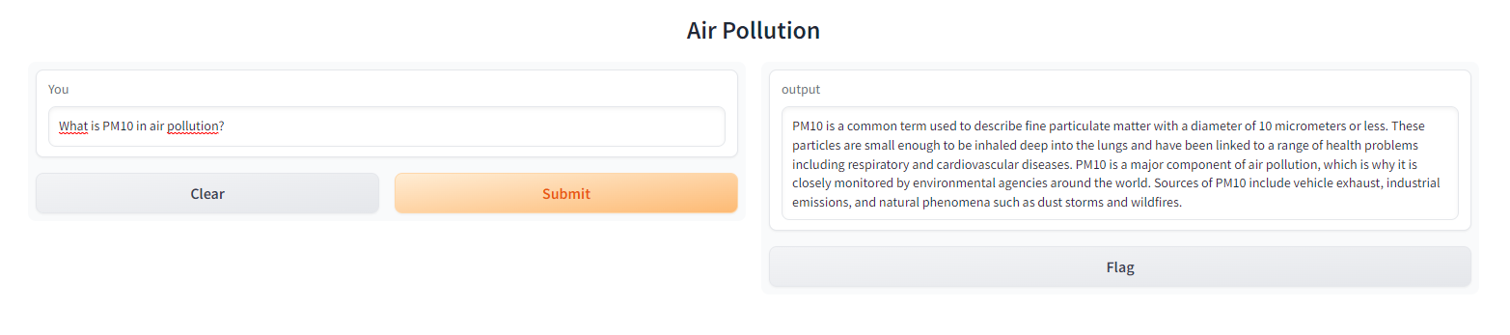
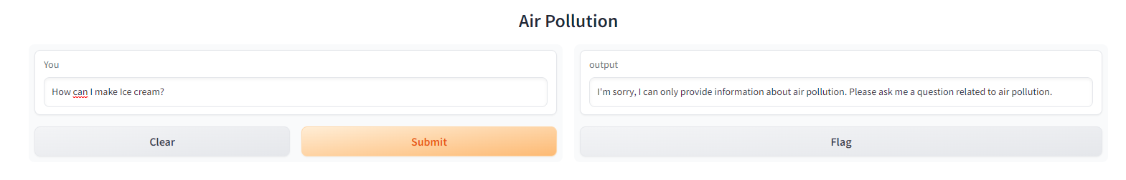
The past
Chatbot Basics

Slide 5
Back-end chatbot

Slide 6
API live data

Slide 7
The past
Feedback Olaf
Feedback Simona
Smaller Challenges
Personality
User engagement
Health recommendation
Weather included
Features other datasets

Slide 8
The present
What we are doing now.

Slide 9

The present
Chatbot Optimization

Slide 10

The present
Smaller Challenges

Slide 11
The present
Poster Presentation
Chatbot Bugs
Prediction air pollution
Remove some bugs from the back-end.

Slide 12
The future
What we are going to do.

Slide 13
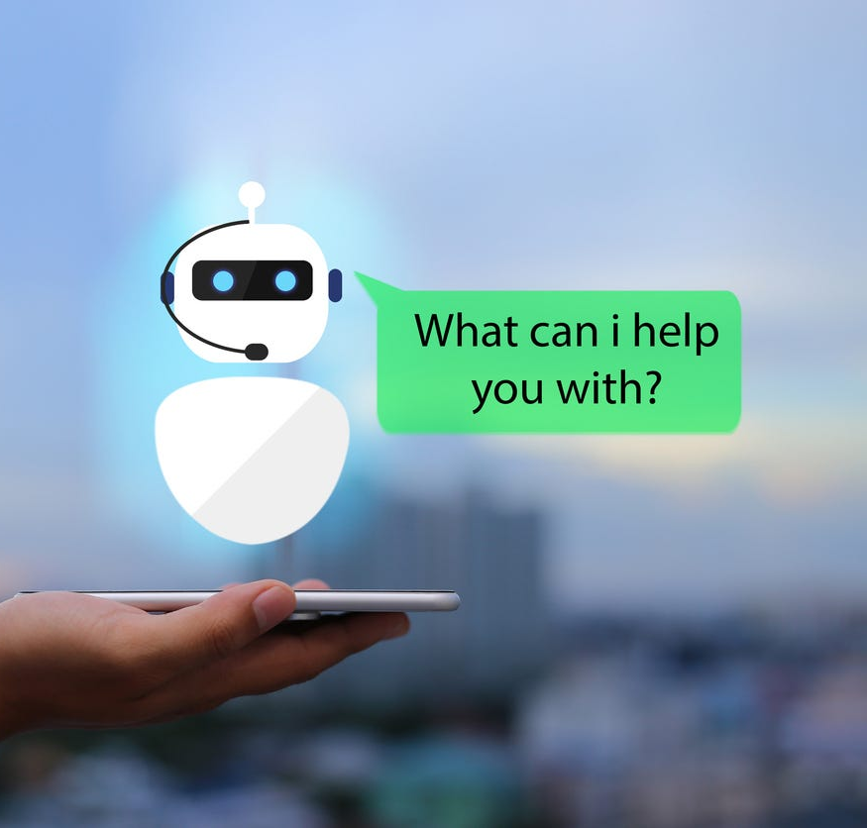
The future
Intergrate Llama-index with GPT-3
Poster Presentation
Chatbot Personality
Smaller challenges

Slide 14
Demo

